Slide 1
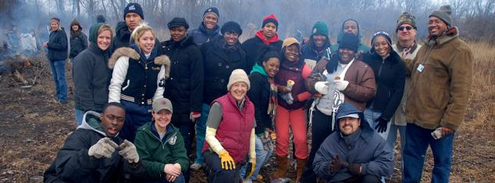
Successes and Challenges in
Creating the Next Generation of Conservation Leaders
Notes:
Today we will talk about how a wide range of people/programs is needed to support the next gen of conservation leaders, based on our work in the Chicago Wilderness region.
This panel of practitioner experts will highlight various approaches to supporting the next generation of conservation leader with an emphasis on best practices as well as challenges to fostering youth environmental leadership and report the work of the region-wide CW Next Generation of Conservation Leaders Working Group.
Many of you here in the room know the importance of connecting the next generation to conservation – obviously, you came to this session – but we are at an important point in helping connect the next gen within CW to conservation careers and lifestyles.

Slide 2
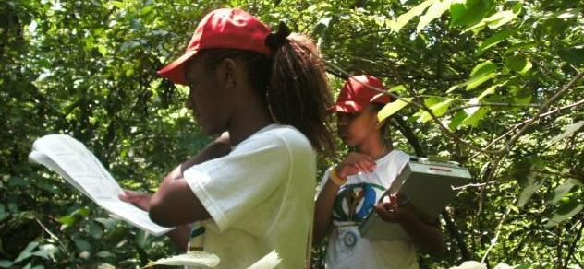
Today’s Presentation:
Research and Recommendations from the Chicago Wilderness Next Generation of Conservation Leaders Working Group
Best Practices and Common Program Challenges:
3 Case Studies
Discussion
Notes:
What we’ll be doing today:
Talking about how we, in Chicago Wilderness, are coming together to answer the question how can we support a diverse next gen of young people pursuing conservation careers and environmentally-friendly lifestyles
Presenters will talk about local and national trends in connecting young adults to nature and conservation careers.
We will leave some time for a discussion on how conservation professionals can ensure that young adults have the opportunity to pursue conservation careers and connect with nature.
We’ve shared this information within CW and today we are excited to share with you - to gain some national perspective on this important issue
What is CW? What is the Next Gen group? Our findings, recommendations and success and challenges
Highlight three programs that highlight some of the local and national trends in connecting young adults to nature and conservation careers
There’s a real breadth and depth to the programs- there are many great programs and it’s good to see the variety of things that are being provided in the region
TFM, SCA, and PNNM will share a variety of approaches that highlight both their successes and challenges
3) Talk about the challenges and successes that the conservation community needs to examine to support a diverse next gen of leaders

Slide 3
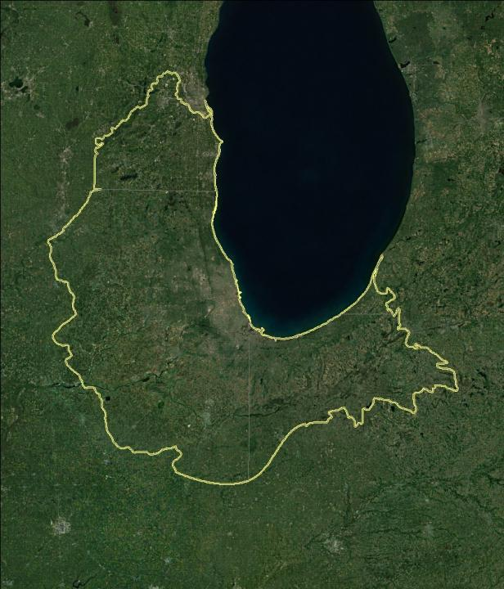

Over 300 organizations
545,000 acres
Four key initiatives
  Restoring Narure
  Climate Action
  Leave No Child Inside
  Greening Infrastructure
Notes:
Chicago Wilderness is a regional alliance that connects people and nature.
We are more than 300 organizations working together to restore local nature and improve the quality of life for all who live here, by protecting the lands and waters on which we all depend.
The members of Chicago Wilderness include local, state and federal agencies, large conservation organizations, cultural and education institutions, volunteer groups, municipalities, corporations, and faith-based groups.
Our region — including southeast Wisconsin, northeast Illinois, northwest Indiana and southwest Michigan, holds nearly 545,000 acres of protected lands and waters, as well as many that remain unprotected. Our landscape includes prairies, wooded communities, Lake Michigan and other water communities.
Our four key initiatives—to restore nature to health, to protect green infrastructure, to mitigate climate change, and to leave no child inside—reflect our commitment to using the best science, a collaborative approach to conservation, and a caring for both people and nature, to benefit all the region’s residents. The initiatives direct our efforts to protect and restore healthy, functioning natural systems that support healthy, vibrant communities across the region.
We work at the landscape scale, because the ecosystems and watersheds that support the 10 million people living in the Chicago metropolitan region span parts of four states and cover 9,400 square miles. Our goal is to incorporate a third of this area into an interconnected network of lands and waterways to ensure a healthy and sustainable region for people and nature.
We coordinate the efforts of diverse organizations, agencies, and businesses around regional priorities—Chicago Wilderness strategically focuses efforts, fosters networks, attracts new partners, creates shared tools, builds organizational capacity, and works toward systemic solutions that can only be accomplished through collaboration. We work efficiently, learn and adapt, and attract new resources to leverage the regional investments of the diverse members of Chicago Wilderness
Restoring Nature: Members of Chicago Wilderness are making significant improvements in the ecological health of the region’s natural systems and engaging residents as stewards of the region’s lands and waters.
Climate Action: We are developing strategies to mitigate climate change through land and water conservation action, and implementing the Chicago Wilderness Climate Action Plan for Nature, the first plan of its kind to link climate change specifically to issues of biodiversity conservation.
Leave No Child Inside: We are raising public awareness about the importance of access to nature for healthy childhood development, and providing the places and programs for generations of families to connect with nature.
Greening Infrastructure: We are creating a region where healthy ecosystems contribute to economic vitality and a high quality of life for all residents.

Slide 4






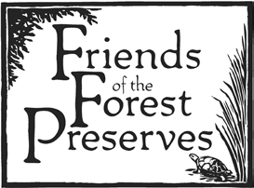









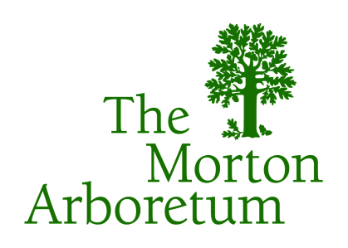

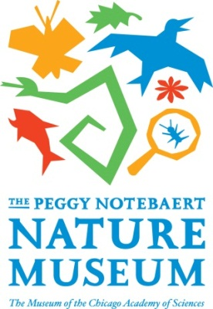
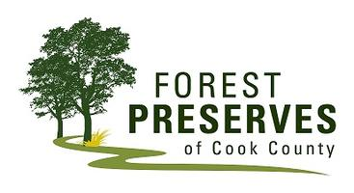



Chicago Wilderness Next Generation of
Conservation Leaders Working Group
Notes:
The CW Next Generation of Conservation Leaders Working Group came together about two years ago.
This effort has been a tribute to the value and the success of Chicago Wilderness! Over the past two years – core group of 25 individuals that met to answer the question: how do we best support the next generation of conservation leaders in the CW region.
We saw a need and the CW structure allowed for us to easily collaborate and work together to provide a regional approach to collectively address this issue.
We launched into the implementation phase towards the end of 2013 and have seen a huge influx of energy into the group.

Slide 5

“Ensure that programming is offered for children of all ages, from toddlerhood through college, to create progressive opportunities for engagement and the eventual development of the next generation of conservation leaders.”
Notes:
We came together around the want to ensure that programming is offered…..as seen in the LNCI framework. We saw a real need to connect the experiences from cradle to career and/or adulthood in order to have a knowledgeable and passionate next generation of conservation leaders.
Our work has been in two phases – first, research and recommendations and secondly, implementation of those recommendations and today I’m going to talk to you both about our findings and what we’re doing to help ensure that we are best supporting the next generation of conservation leaders.
Our focus was on the upper age range with an eye toward attempting to identify the existing/needed “pipeline” of programming opportunities
Children and families of all backgrounds participate in nature activities consistently and repeatedly across the Chicago Wilderness region.
2. Young people from diverse backgrounds, aged 14 and up, pursue
conservation as a vocation and avocation. It is imperative that once we expose children to the benefits of unstructured time in nature, we build upon that experience. By ensuring that children can transition from nature play to more formal learning activities, and that they can access a web of conservation programs and related opportunities anywhere in the region, we will keep children engaged into adulthood when they become environmental leaders and advocates themselves.
2.1 Young people from diverse backgrounds can access a web of proven conservation training, education, and career readiness programs everywhere in the Chicago Wilderness region.

Slide 6
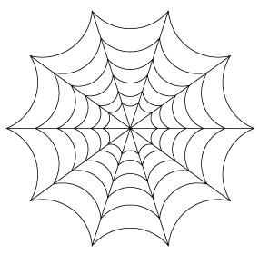
PIPELINE
Notes:
It’s not a pipeline, but rather a web, that together supports our youth in pursuing conservation as a vocation and/or an avocation.
Our work is to look at how make this a stronger, better web of opportunities.

Slide 7
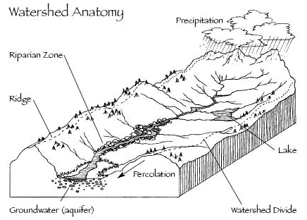
Leave No Child Inside → Next Generation
Unstructured Nature Play
Mighty Acorns
Conservation Education Programs
Academic and Career Readiness Opportunities
LNCI Family Events
Capacity Building: Conferences, workshops, etc.
Next Generation of Conservation Leaders
Notes:
Another way that we can think of this is as a watershed. Everything from unstructured nature play as a toddler to environmental education and volunteer work can be seen as contributing to the same goal of creating the next generation of conservation leaders.

Slide 8
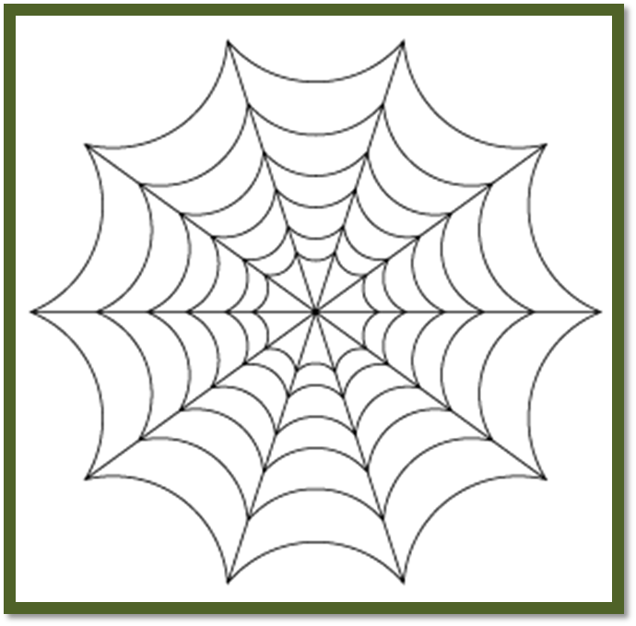

















Building Connections…
Notes:
No particular single starting point; no particular sequence
Need for connection:
Young adults to the wide range of conservation opportunities happening in the region
This includes targeted outreach to young adults of diverse backgrounds

Slide 9
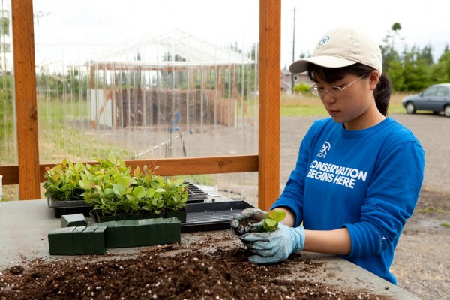
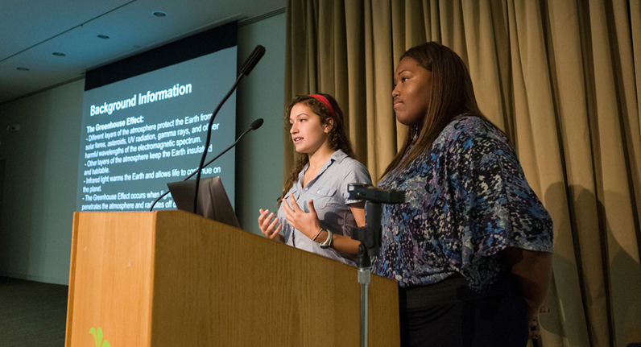
Connect young adults to a wide array of conservation opportunities
Informational Hub
Student Events
Notes:
Linking Students to College and Career Readiness Opportunities
We want more students to take advantage of the array of great program opportunities in the region in order to make the web stronger:
Creation of a Conservation focused Informational Hub – to help students find conservation focused programs, jobs, and internships in the region. We now have over 200 in our database and its growing.
Promotion of Student Events – There is a need for job fairs, networking events, and ways for students to become aware of the variety of conservation careers out there. For example, the CIMBY summit slated for early Feb…..
This is not only for the already conservation-minded folks, but a wide range of people, from many walks of life. We view conservation as a career option but also something that relates to many careers (aka conservation-focused accountants).
Diversity is embedded in this and in the other aspects of what we are doing. We are aiming to reach a diversity of audiences.

Slide 10

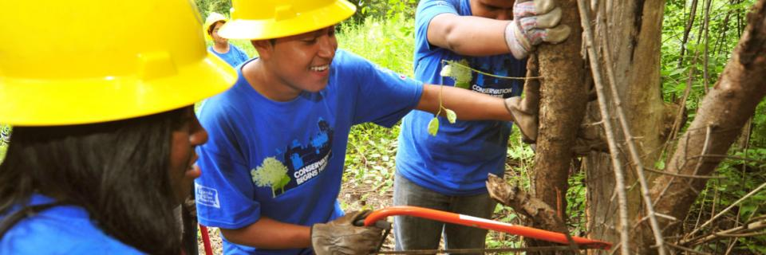
Connect Next Generation programs to each other
Networking Events
Notes:
The web is stronger when we all know about each other and can send our students to others programs.
None of us are one-stop shopping so we want to make sure that program providers are connected so they can in turn connect their students to various opportunities.
This will be achieved through sub-regional networking events, such as Green Drinks, and others. First, get to know each other, then we can best work towards building the connections between programs.

Slide 11
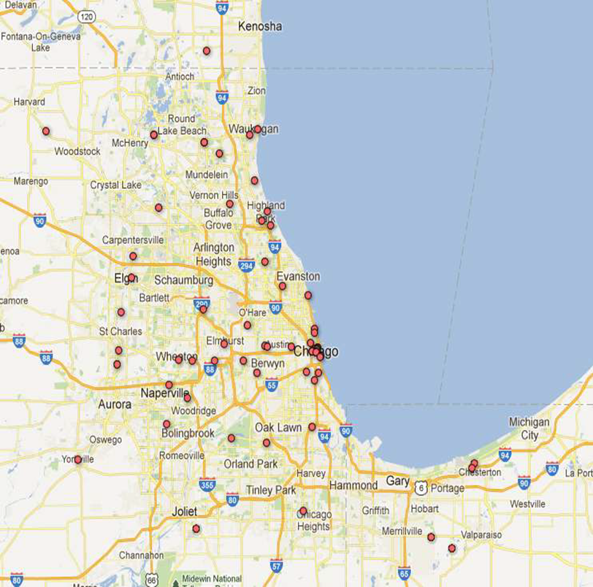
Connect program evaluation
Common goals
Common tools
Notes:
Our evaluation work is being coordinated across the CW Ed efforts (LNCI, MA) and will promote the usage of common evaluation measures across the region, provide support, and promote the sharing of best practices. We have shared outcomes – env. Literacy, etc.
For example, all CW members track program numbers and outcomes. Can we use some common language, or 2-3 metrics across several organizations, to tell a larger story of our collective impact on the region?
We know we need tools, resources, language, to support CW program providers
So, we’re starting by clarifying the goals of education programs in CW, in order to understand how to measure our progress toward them. Some well-established frameworks already exist: the education goals in the CW Biodiversity Recovery Plan, NAAEE’s Framework for Assessing Environmental Education, etc.
Second step will be to develop a matrix of goals for CW programs at the early childhood, primary school, teen, and young adulthood stages which will inform metrics, tools, and methodologies that organizations can use.

Slide 12














Connect Next Gen programs to universities

Slide 13

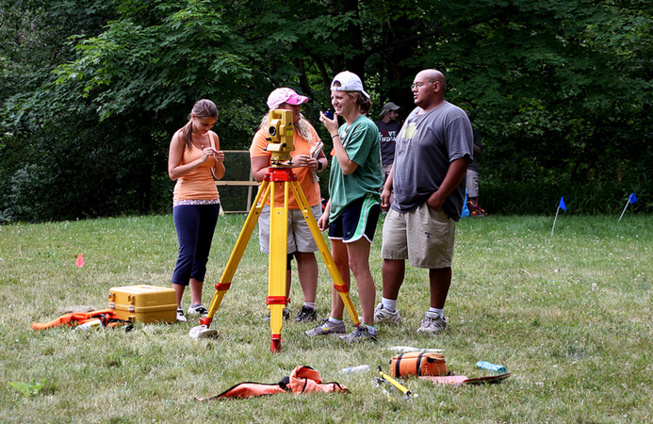







Connect Next Gen programs to employers

Slide 14
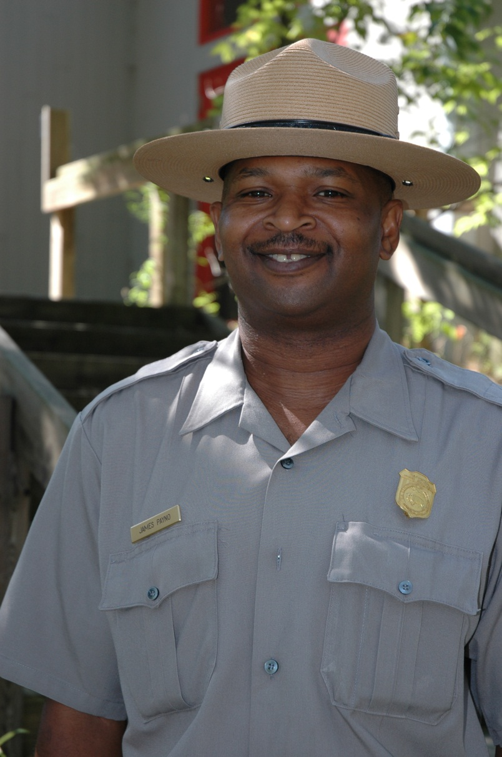
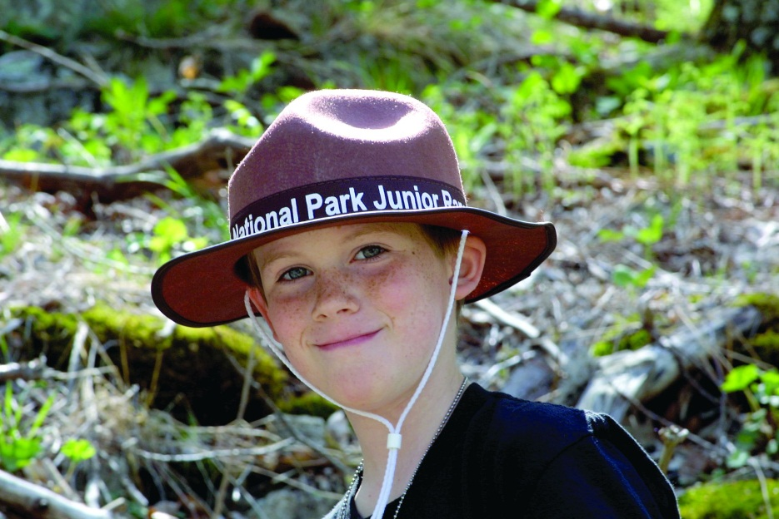
Workforce Development

Slide 15
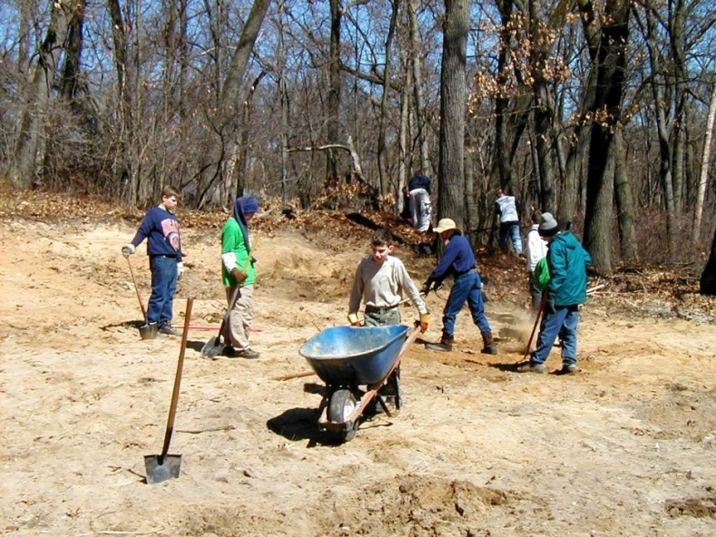
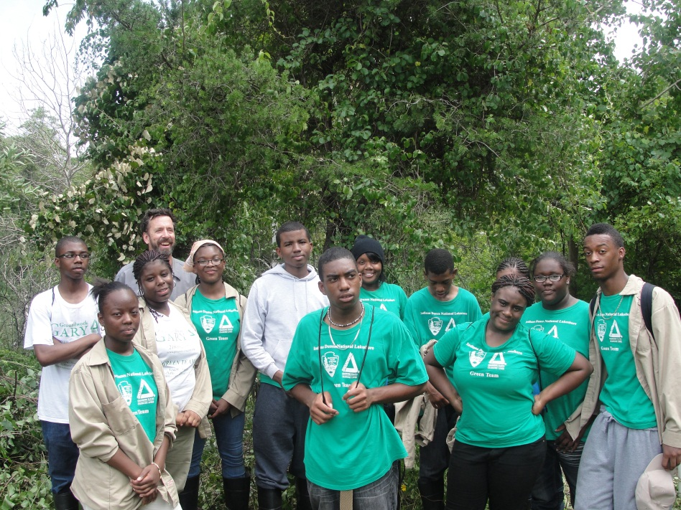
#1-- Develop a recruitment plan or strategy that includes partnering with local community groups that work with diverse youth.

Slide 16
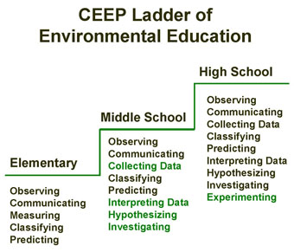
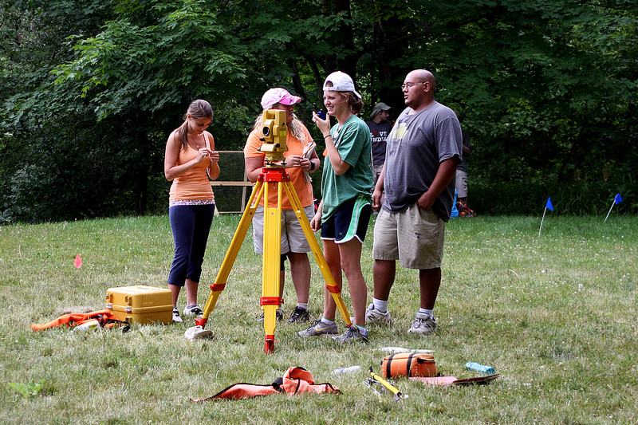
#2-- Provide a rung in the ladder of advancement
and market it on the web and social media.
Ladder of Environmental Education

Slide 17
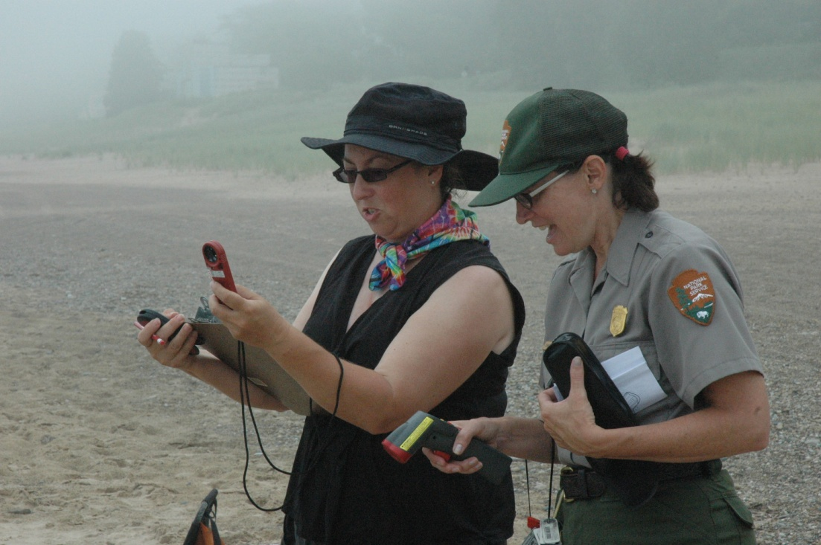
#3--Retaining is as important as recruiting.
Examples—providing certification and training, mentoring, career counseling, and lateral advancement opportunities.

Slide 18
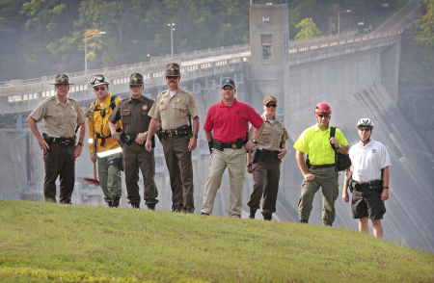
#4--When new positions open up, consider
starting at lower, entry level and making them ladder positions.

Slide 19
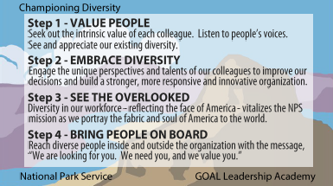
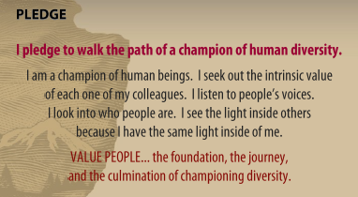
#5--Champion diversity in the workplace.

Slide 20
Work Force Recommendations
The Time is Right for Action in our Region
Large number of retirees in federal agencies in particular
Looking for new skills such as GIS, bilingual skills, and new technology
Connections between other hiring agencies to help provide a ladder of advancement
http://www.youtube.com/watch?v=ZVR8kbAUXUc

Slide 21
Best Practices and Challenges
Notes:
Today we’re going to talk about some of the particular programs within this web
No particular single starting point; no particular sequence
But we know there is a need for connection:
Young adults to the wide range of conservation opportunities happening in the region
This includes targeted outreach to young adults of diverse backgrounds
We’ll now hear from four different practioners that will each highlight some of their challenges and successes in order to show some of the regional best practices and also places for connection

Slide 22
Lessons Learned:
Successes
Successes
Scale is important: program size needs to allows for a focus on individual students
Strong partnerships and networks strengthen student experience and can diversify the conservation field
In-depth engagement equals a long-term commitment in conservation for students
Notes:
Strong partnerships and networks strengthen student experience
College Placement
Community Support
Building curriculum & sharing best practices among educators
Connecting members to future employers*
Small size is important: gets students engaged
Recruitment is hard but once they are there they stay
100% retention rate

Slide 23
Lessons Learned:
Challenges
Challenges
Recruiting participants
Building strong partnerships and networks
Funding
Communications: Sharing the story of our successes
Employment Options
Notes:
Recruiting Participants
Could be due to parent buy in, transportation, not knowing what it is, building trust, other commitments (sports, family, drivers ed, work)
Hard to find the “right” fit
Building Strong Partnerships
Could do more
Not part of people’s job descriptions
Funding
We have great funders - and we need more of them to have a broader impact!
Communications
Parents
Students
With funders
Employment options
Shifting job market for conservation careers
What we mean by conservation is also changing
And it can take a while to finding a solid, conservation career (ties to diversity)

Slide 24
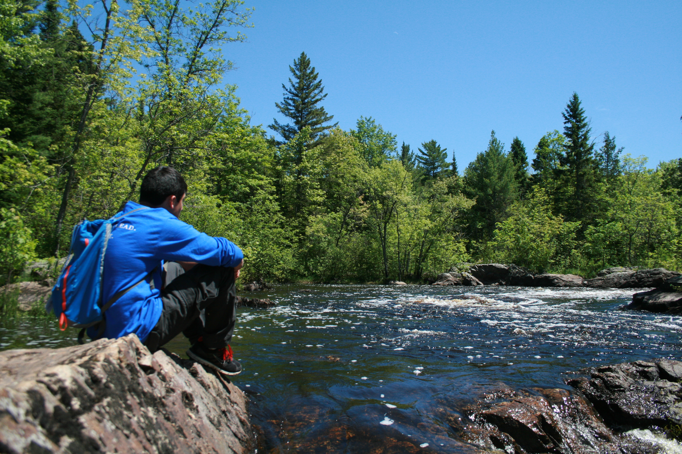
Discussion
How can the conservation community best make the connections needed to support
the next generation of conservation leaders?

Slide 25
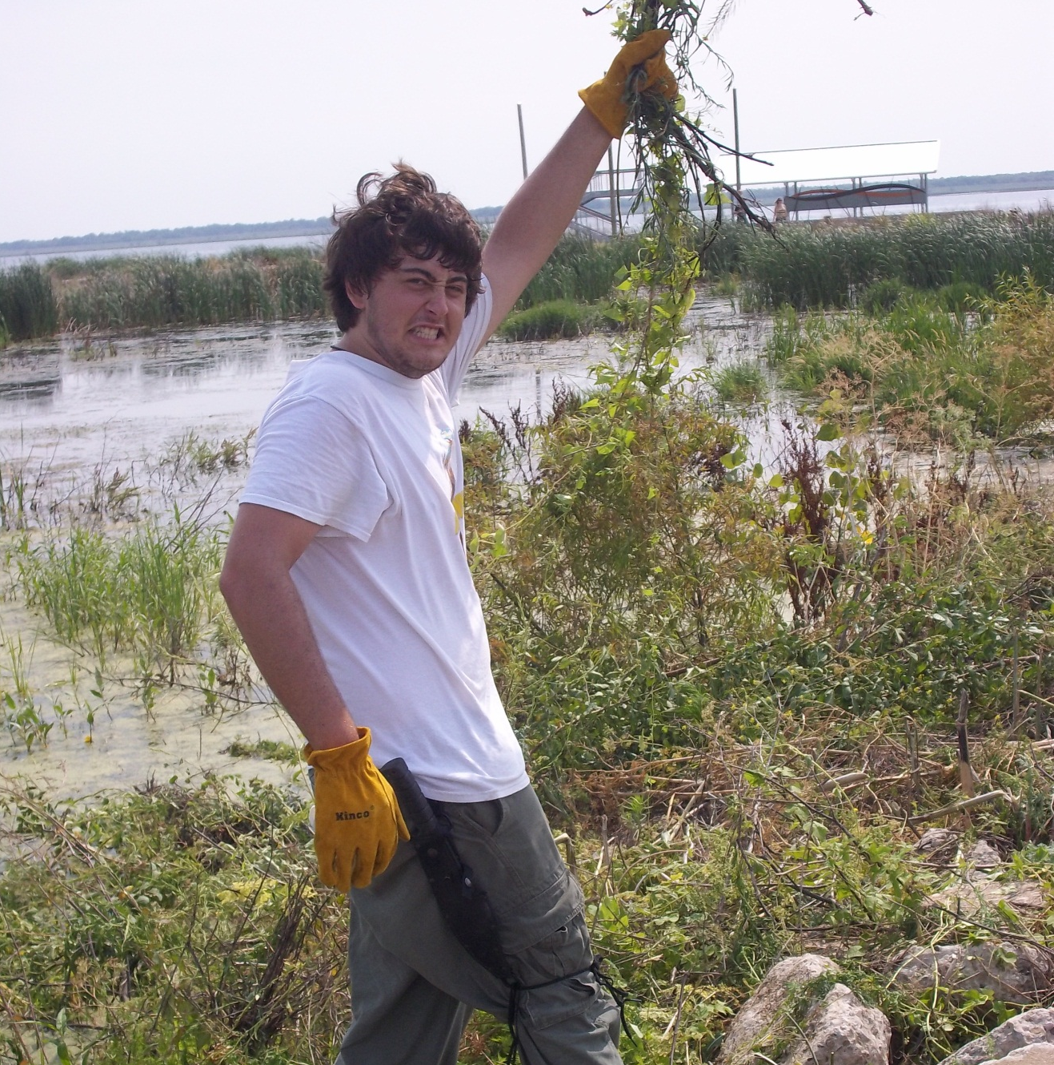
Chicago Wilderness
Next Generation of Conservation Leaders Working Group
For more information:
Alison Paul
apaul@fieldmuseum.org
David Bild
dbild@naturemuseum.org
Laura Milkert
lmilkert@fieldmuseum.org
Carina Ruiz
cruiz@thesca.org

